Slide 1
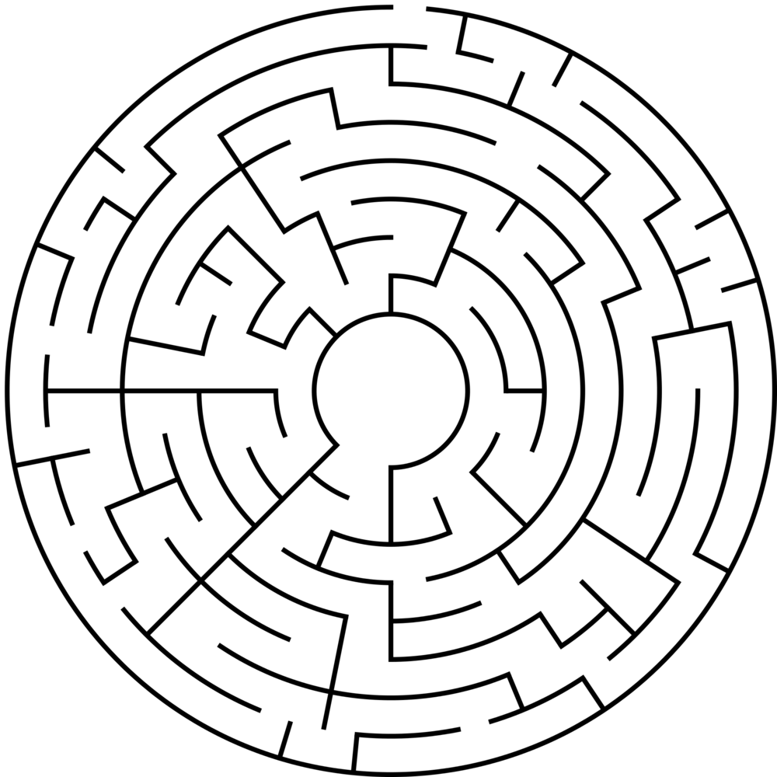
E
S
C
A
P
E
R
O
O
M
S
S
@
Y
O
U
R
R
L
I
B
R
A
R
Y
Andrew
Freshwater
&
Elizabeth
Prewitt

Slide 2
E
S
C
A
P
E
R
O
o
m
S
@
Y
O
U
R
L
I
B
R
A
R
Y
Public libraries: interesting and entertaining
School libraries: introduce the library and library resources to students
Academic libraries: intro to library databases & libguides

Slide 3
P
L
A
N
N
I
N
L
G
Y
O
U
R
E
S
C
P
E
A
E
R
O
o
m

Slide 4
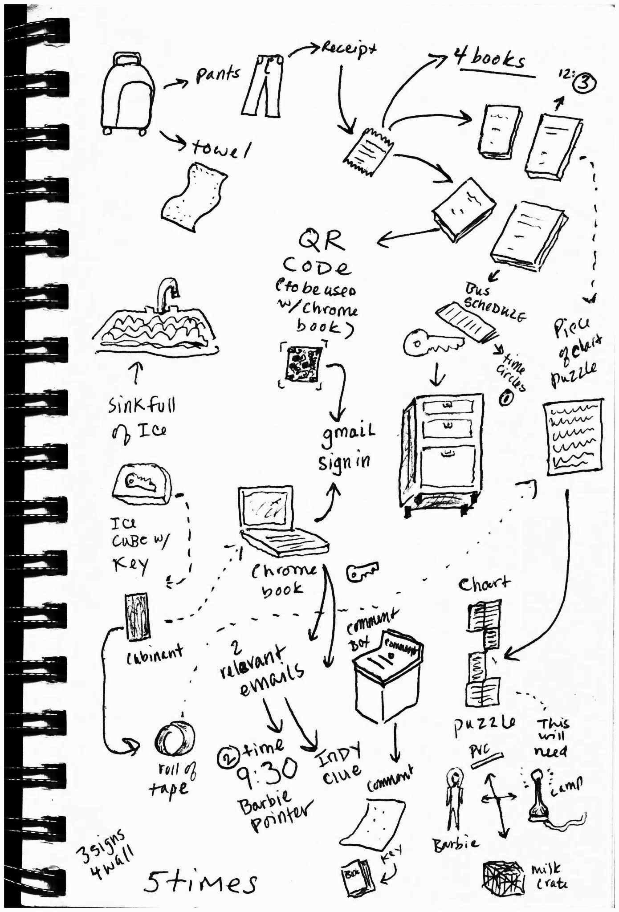
P
L
A
N
N
N
G
I
DIY Escape room?
Pros & Cons
Breakout EDU
Pros & Cons

Slide 5
P
L
A
N
N
I
N
P
G
Find your theme or premise
Look around for inspiration
Don’t limit ideas
Give yourself time to gather resources

Slide 6
P
L
A
N
N
N
G
I
Involve coworkers, outside groups, volunteers, students, etc.
Incorporate different puzzle “types”
Map the room, set the sequence
TEST PUZZLES IN ADVANCE!!

Slide 7
E
S
C
A
E
P
R
O
o
m
S
@
P
r
a
i
r
i
e
C
o
m
o
n
m
s

Slide 8
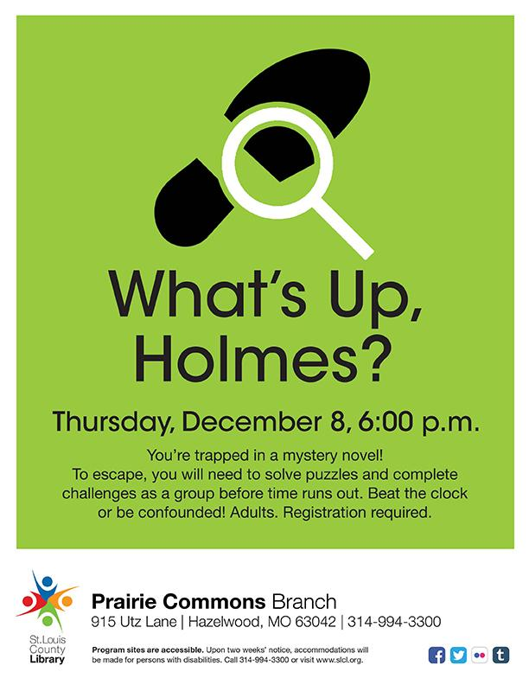
W
h
a
t
‘S
U
p,
H
O
L
M
E
S
?
Set-up & Premise:
First escape room at Prairie Commons
No specific theme (detective school?)
No budget
Staff of three (YS “kidnapped”)
Generic puzzles & ideas gathered from online resources
Four start times, registration limited to 10 per session
Promoted to book clubs

Slide 9
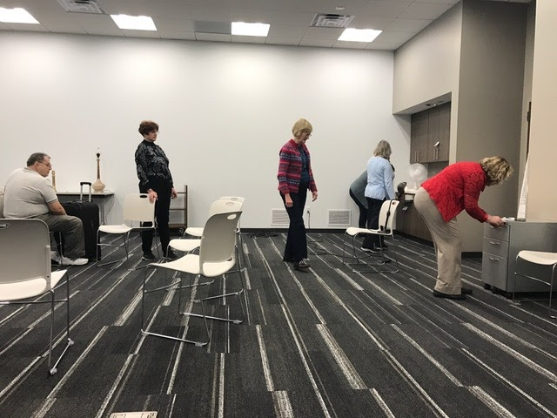
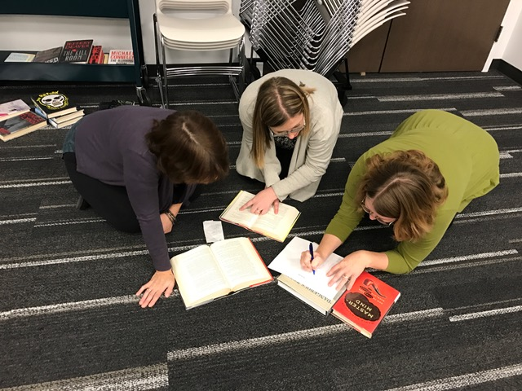
W
h
a
t
‘S
U
p,
H
O
L
M
E
S
?
Puzzles & Props:
Puzzles using household junk
Oscillating fan (hidden code & key)
Icecubes
Chromebook “hack” & emails
Books--Dewey #’s, titles, overlay
Locked suitcase, “little boy pants” and checkout receipts
Barbie on a stick, codex, lamp, and the “Staff of Ra” scene from Indiana Jones

Slide 10
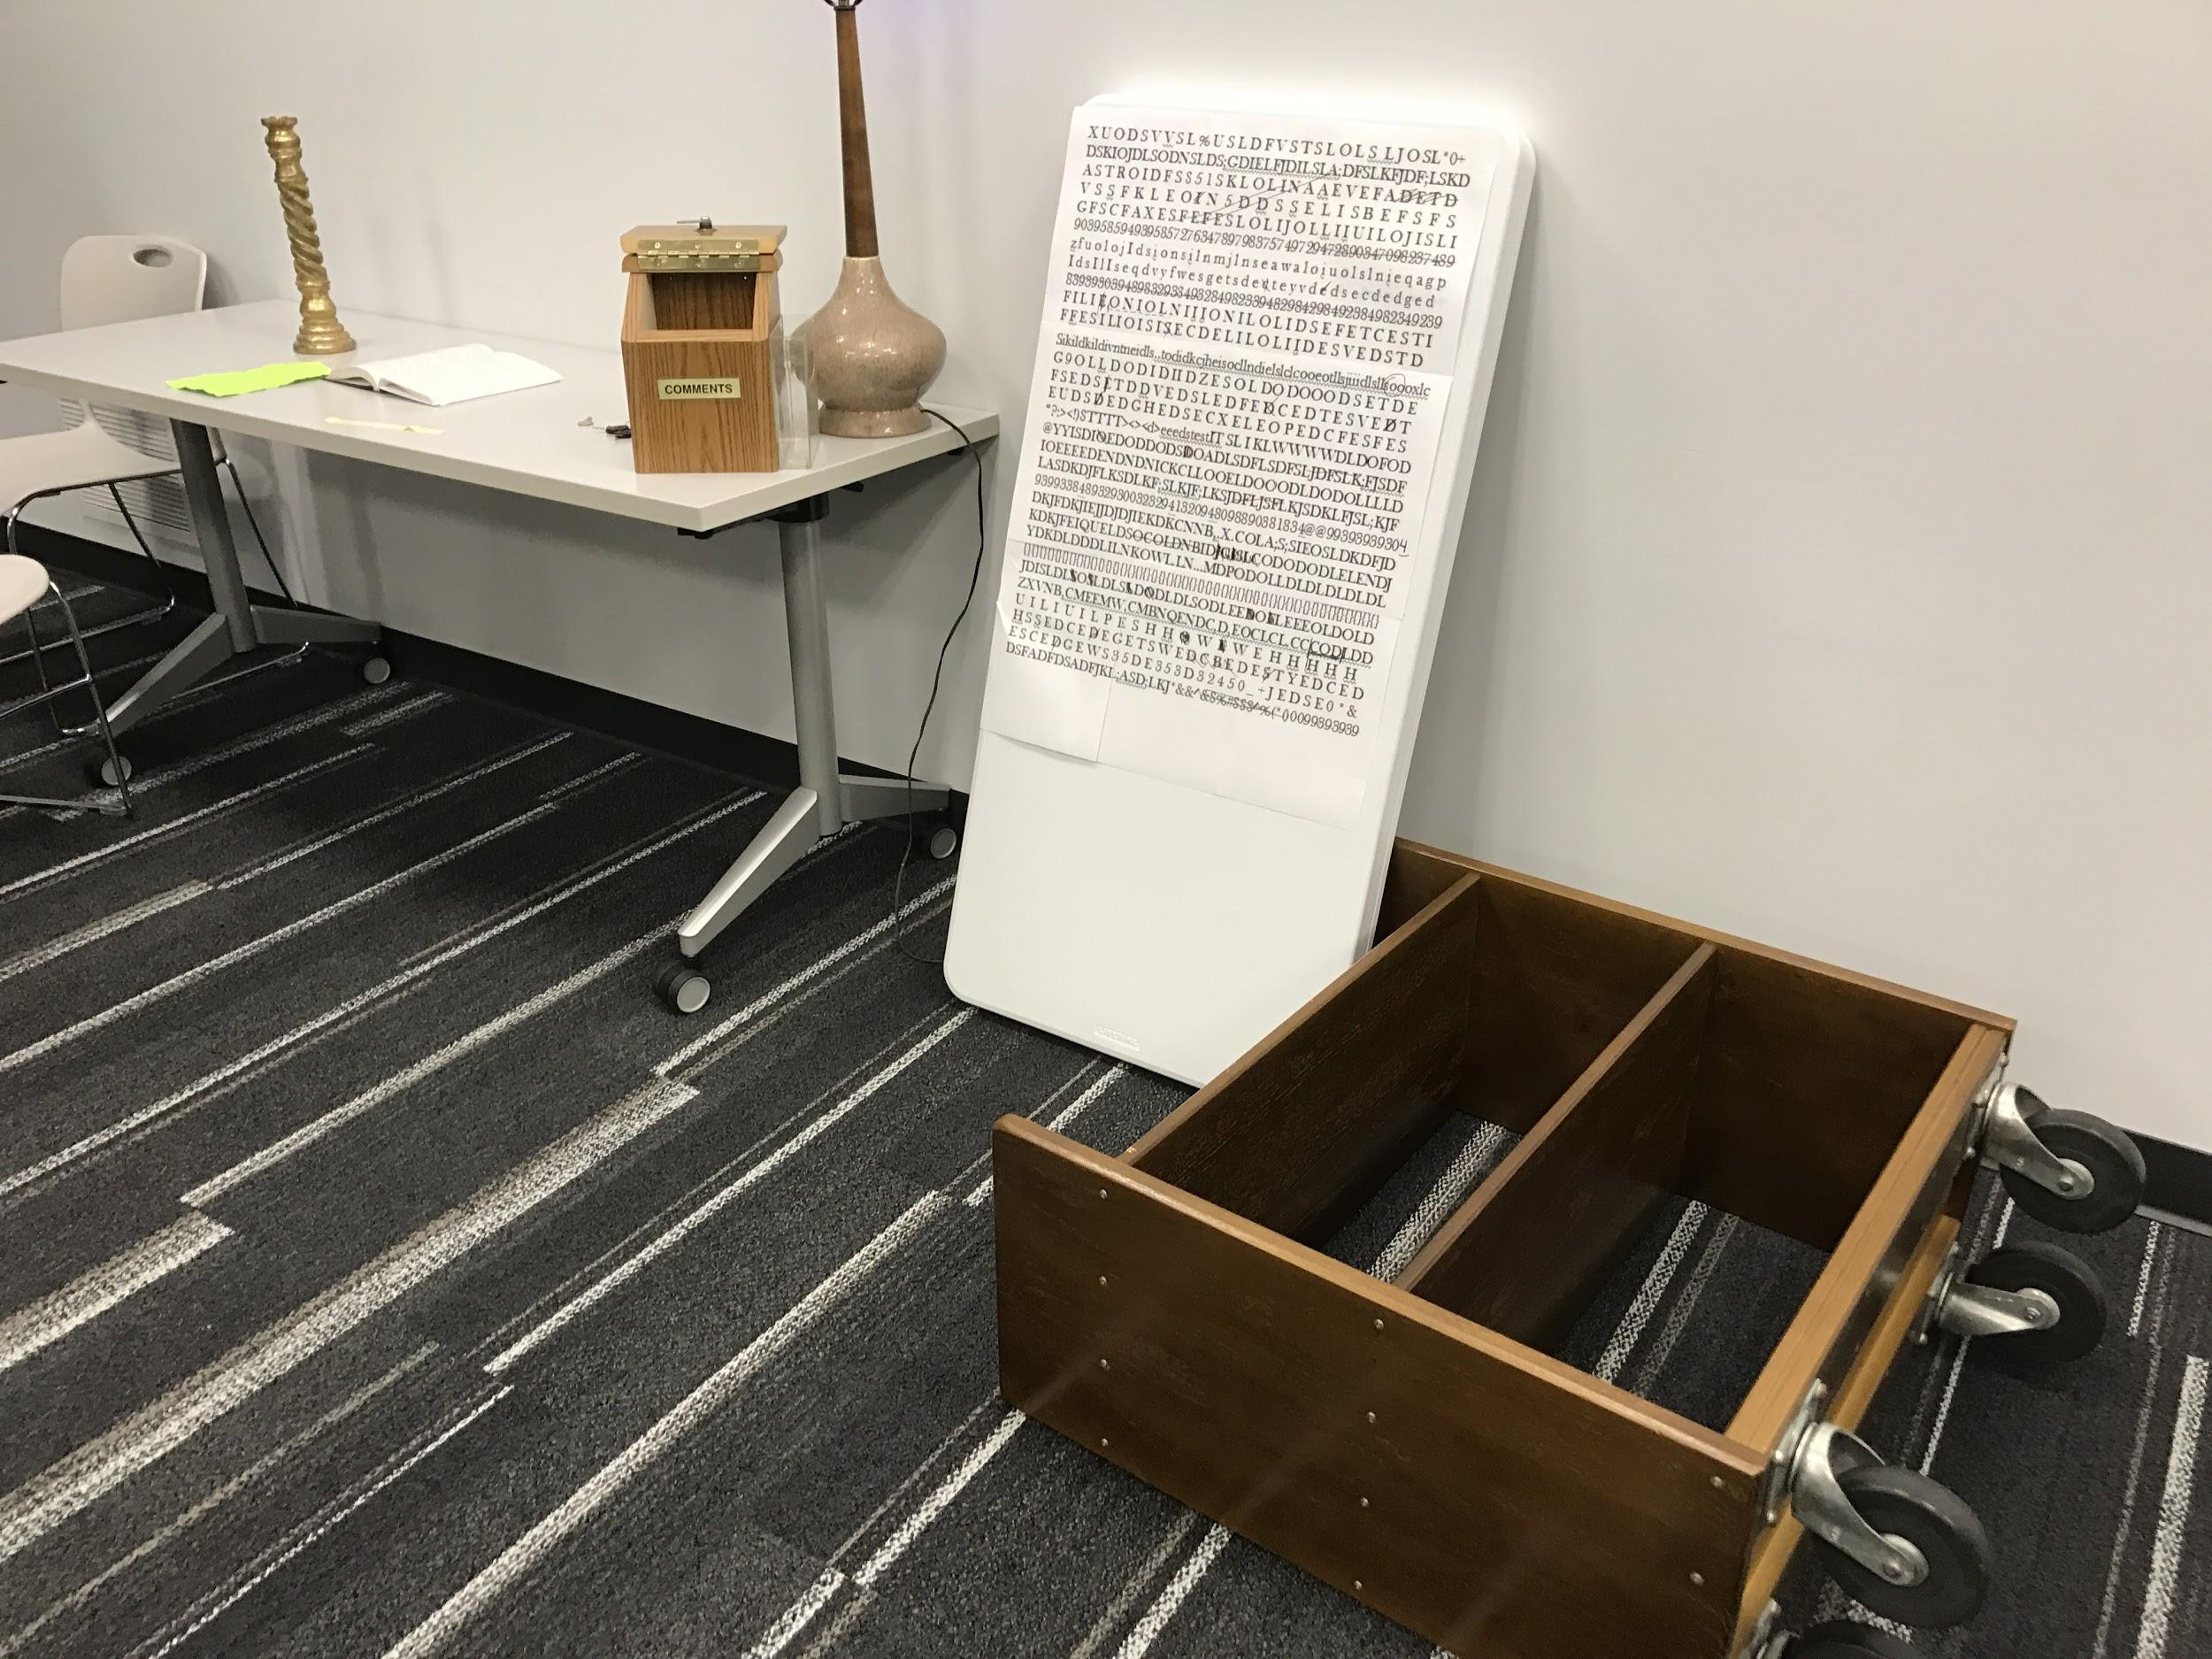
W
h
a
t
‘S
U
p,
H
O
L
M
E
S
?
Problems
Lack of premise
No thorough puzzle testing
One faulty light bulb
Tricky red herring?
Boring? Not enough stagecraft, props
Not enough time for set up

Slide 11
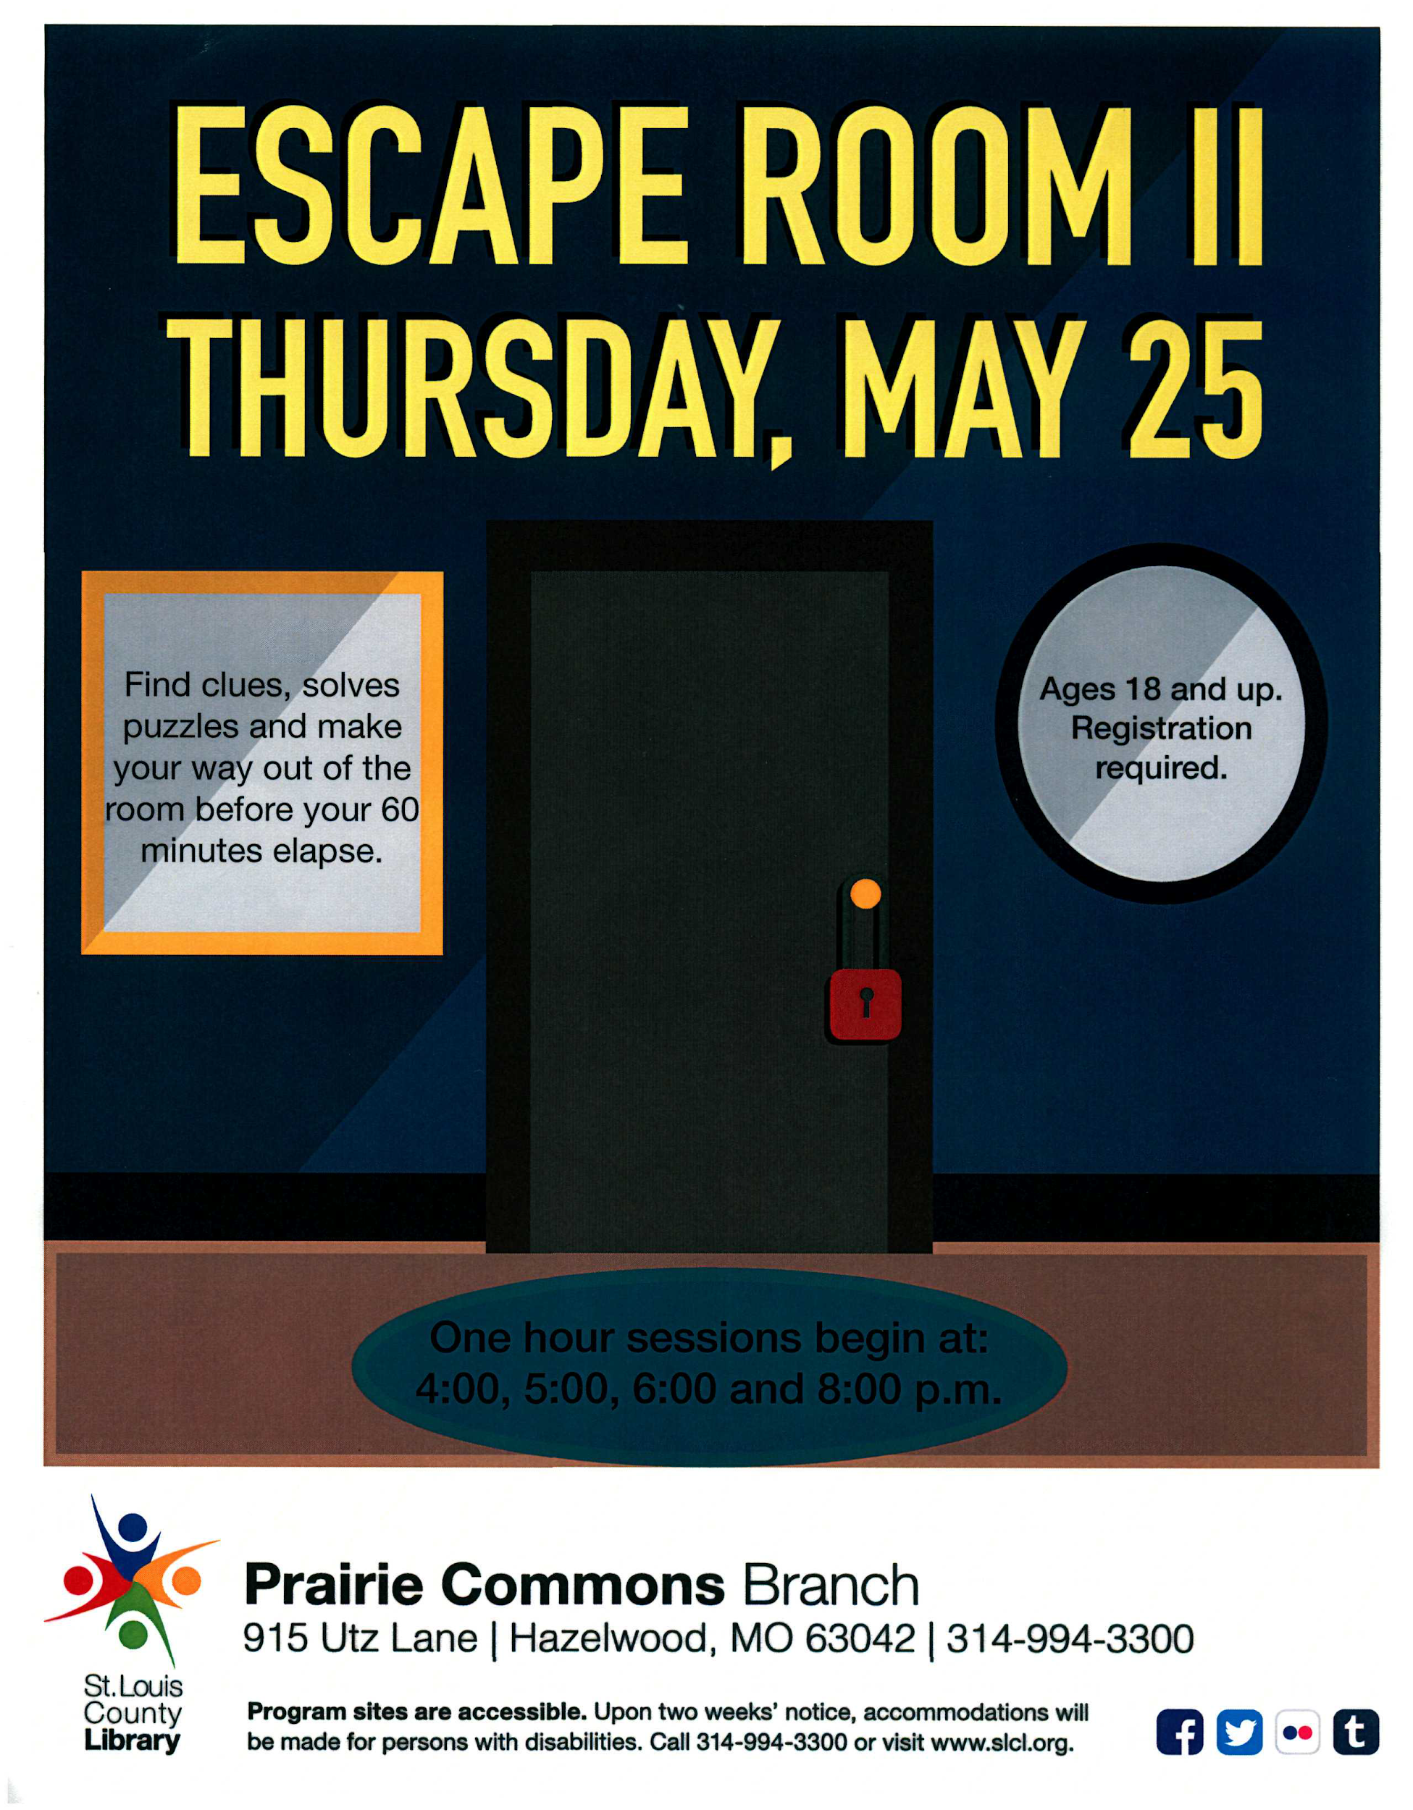
E
S
C
A
P
E
R
O
O
II
:
M
the
E
S
C
A
p
e
n
i
N
g
Set-up & Premise:
Marketed as Escape Room
More effort to develop theme and plot
Slightly bigger budget
Booked meeting room hours in advance for set up
Built our own puzzles
Sci-fi B movie props

Slide 12
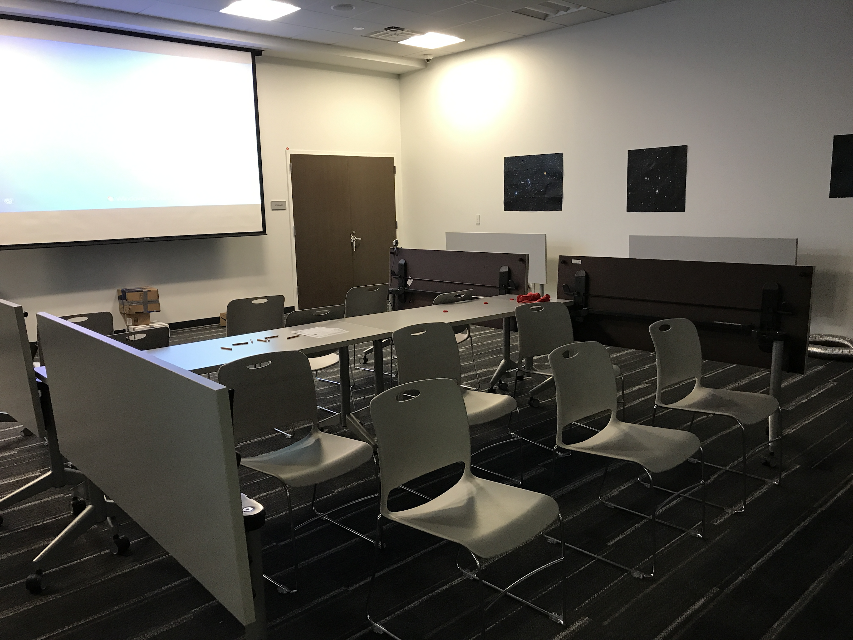
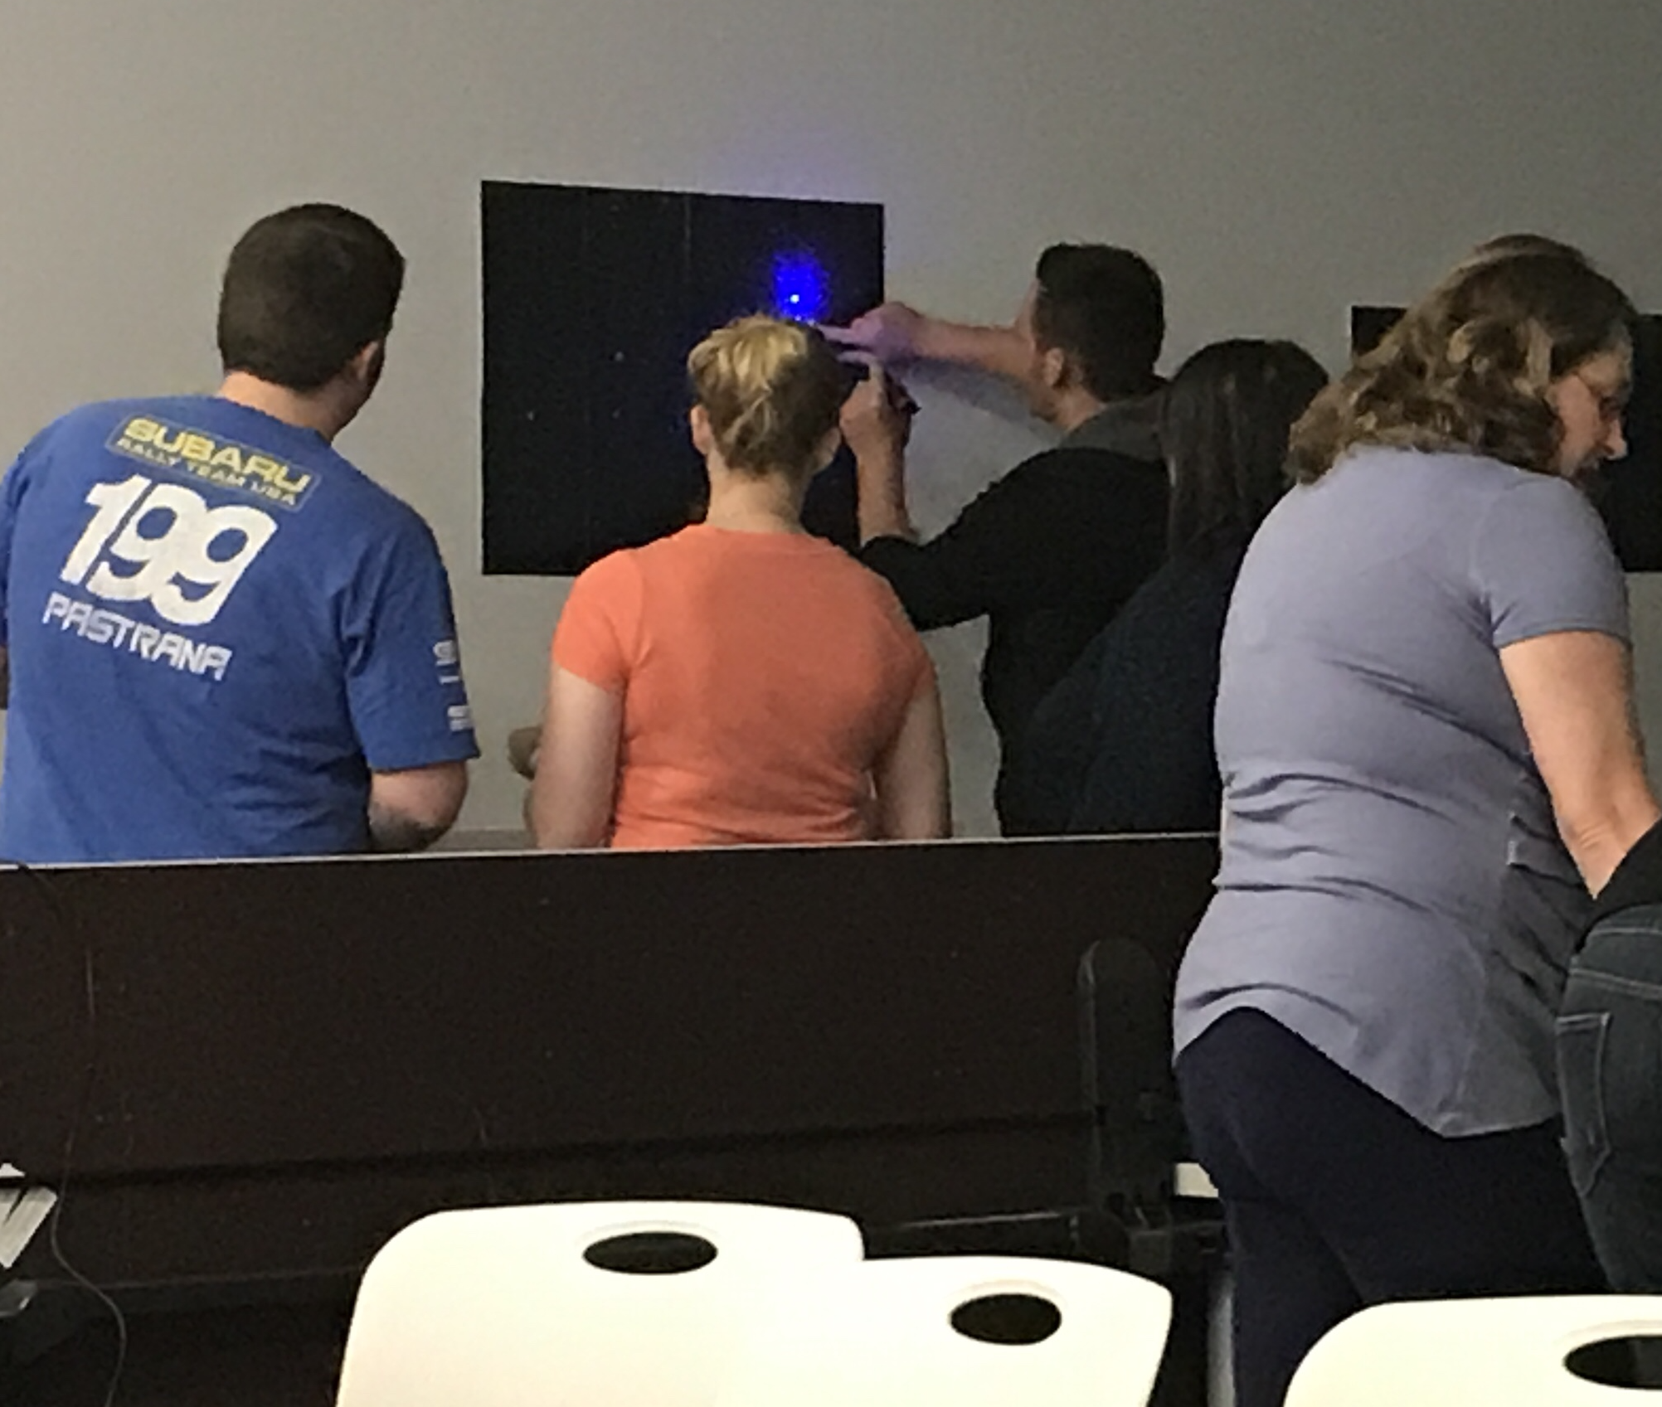
E
S
C
A
P
E
R
O
O
II
:
M
the
E
S
C
A
p
e
n
i
N
g
Puzzles & Props:
Connect four grid + checkers
Constellations/maps/starguide
PVC and drain snake
Box of ping pong balls, numeric code
Locks and more locks
Slideshow (count down & red herring)

Slide 13
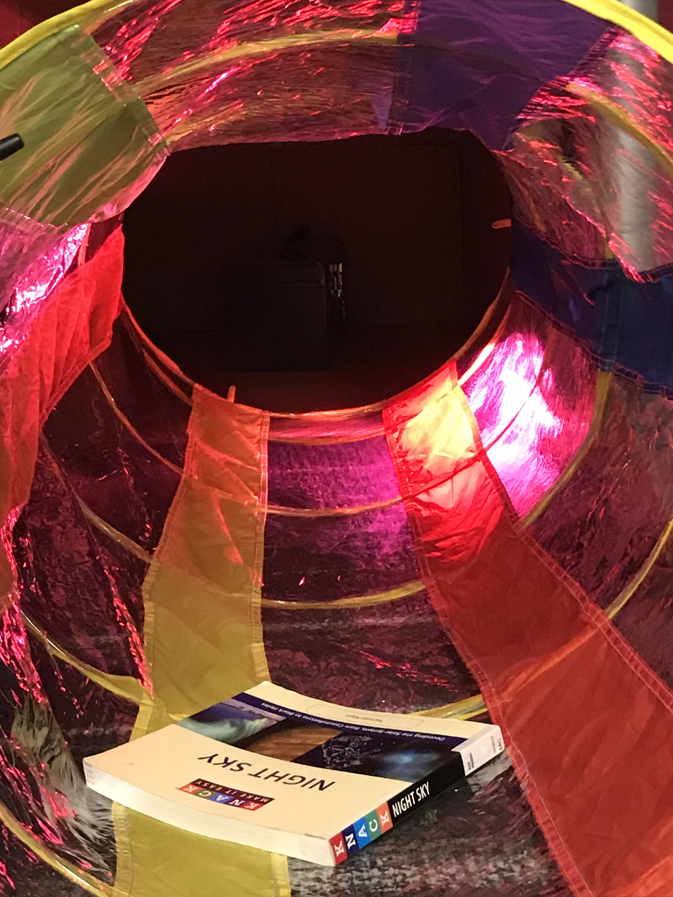
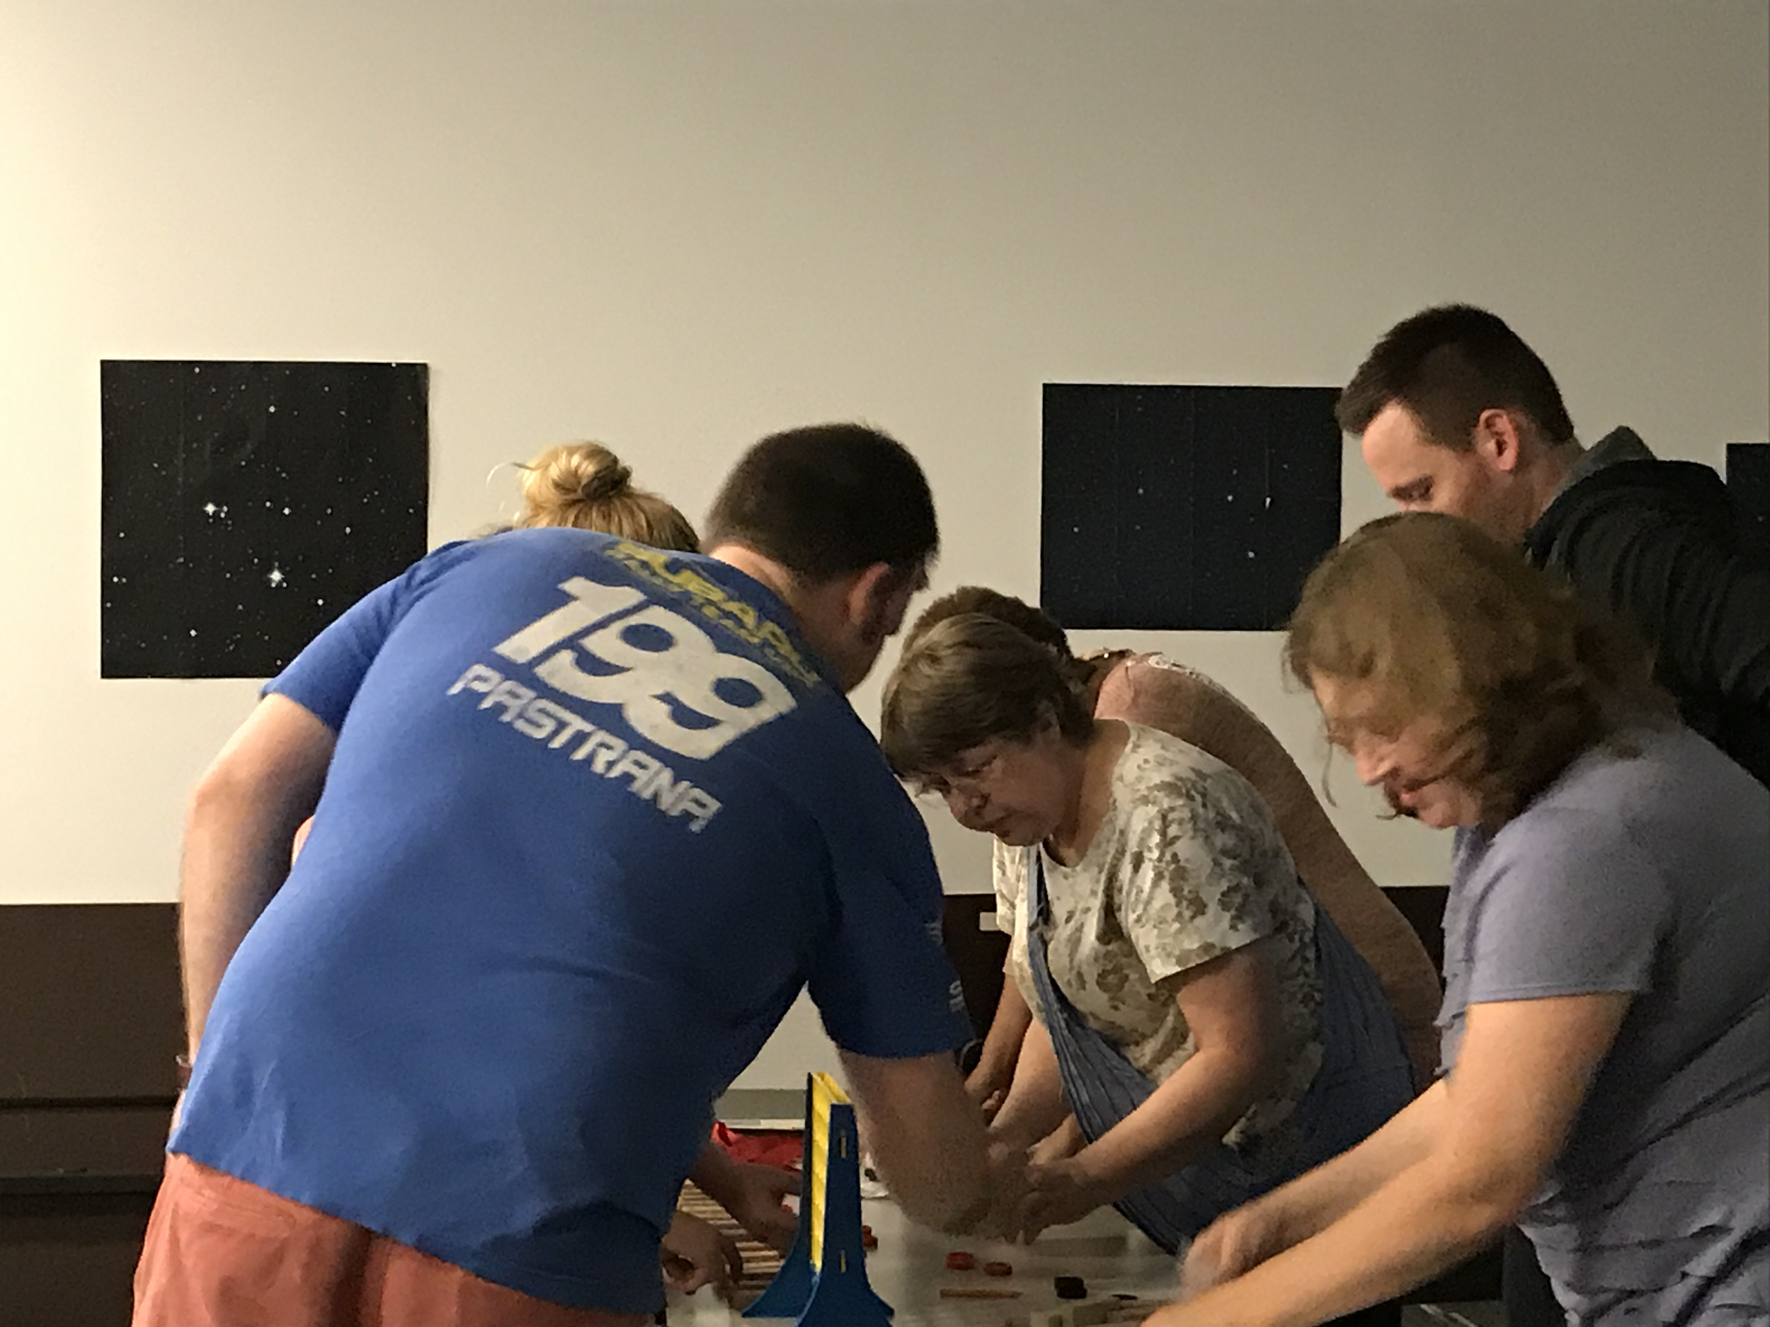
E
S
C
A
P
E
R
O
O
II
:
M
the
E
S
C
A
p
e
n
i
N
g
Problems:
Still kinda boring?
Not enough guidance
Ping pong ball clean up
Another tricky red herring

Slide 14
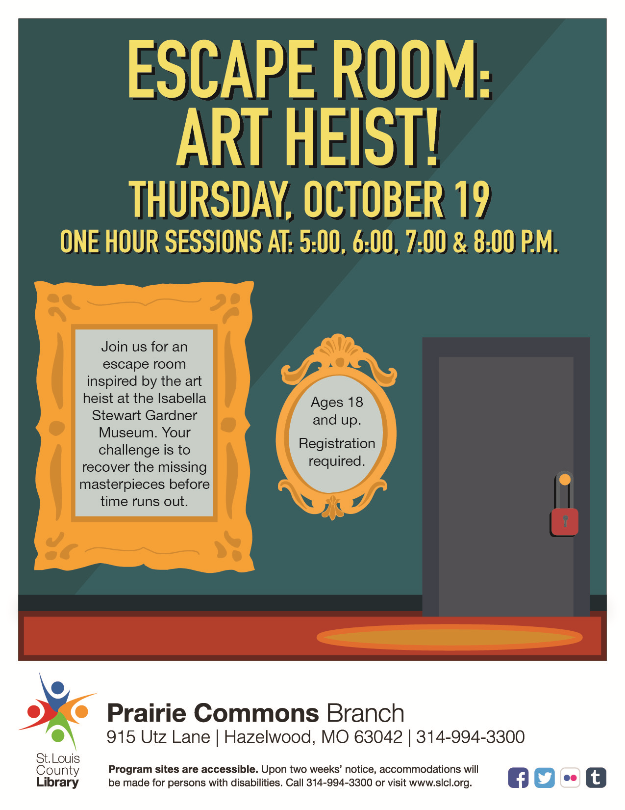
G
A
R
D
N
E
R
M
U
S
E
U
M
M
Y
S
T
E
R
Y
Set-up & Premise:
Based on infamous art heist
More specific premise
Increased budget
More effort to transform the meeting room, incorporate props

Slide 15
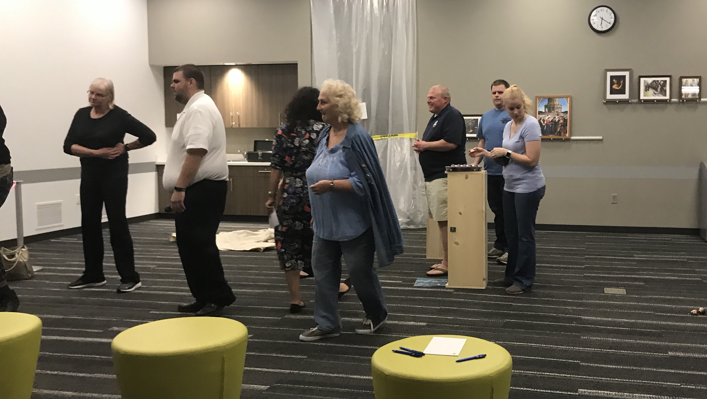
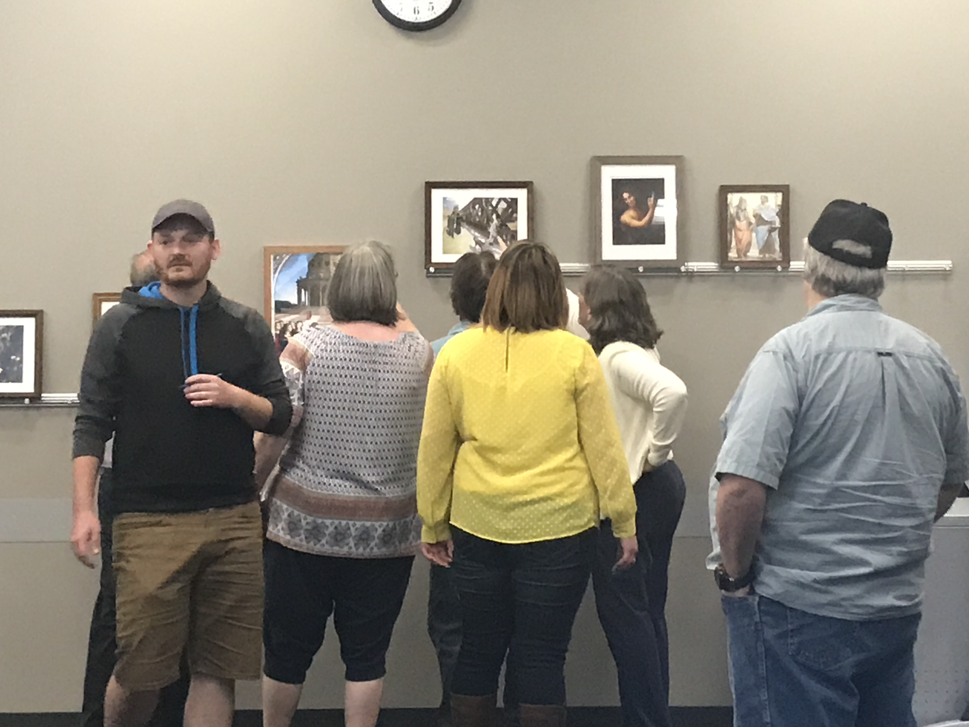
G
A
R
D
N
E
R
M
U
S
E
U
M
M
Y
S
T
E
R
Y
Puzzles & Props:
“Avant Garde” video (card catalog clue)
Pop art egg sculptures
Paintings with dramatic vanishing points
Balloons for museum’s gala event

Slide 16
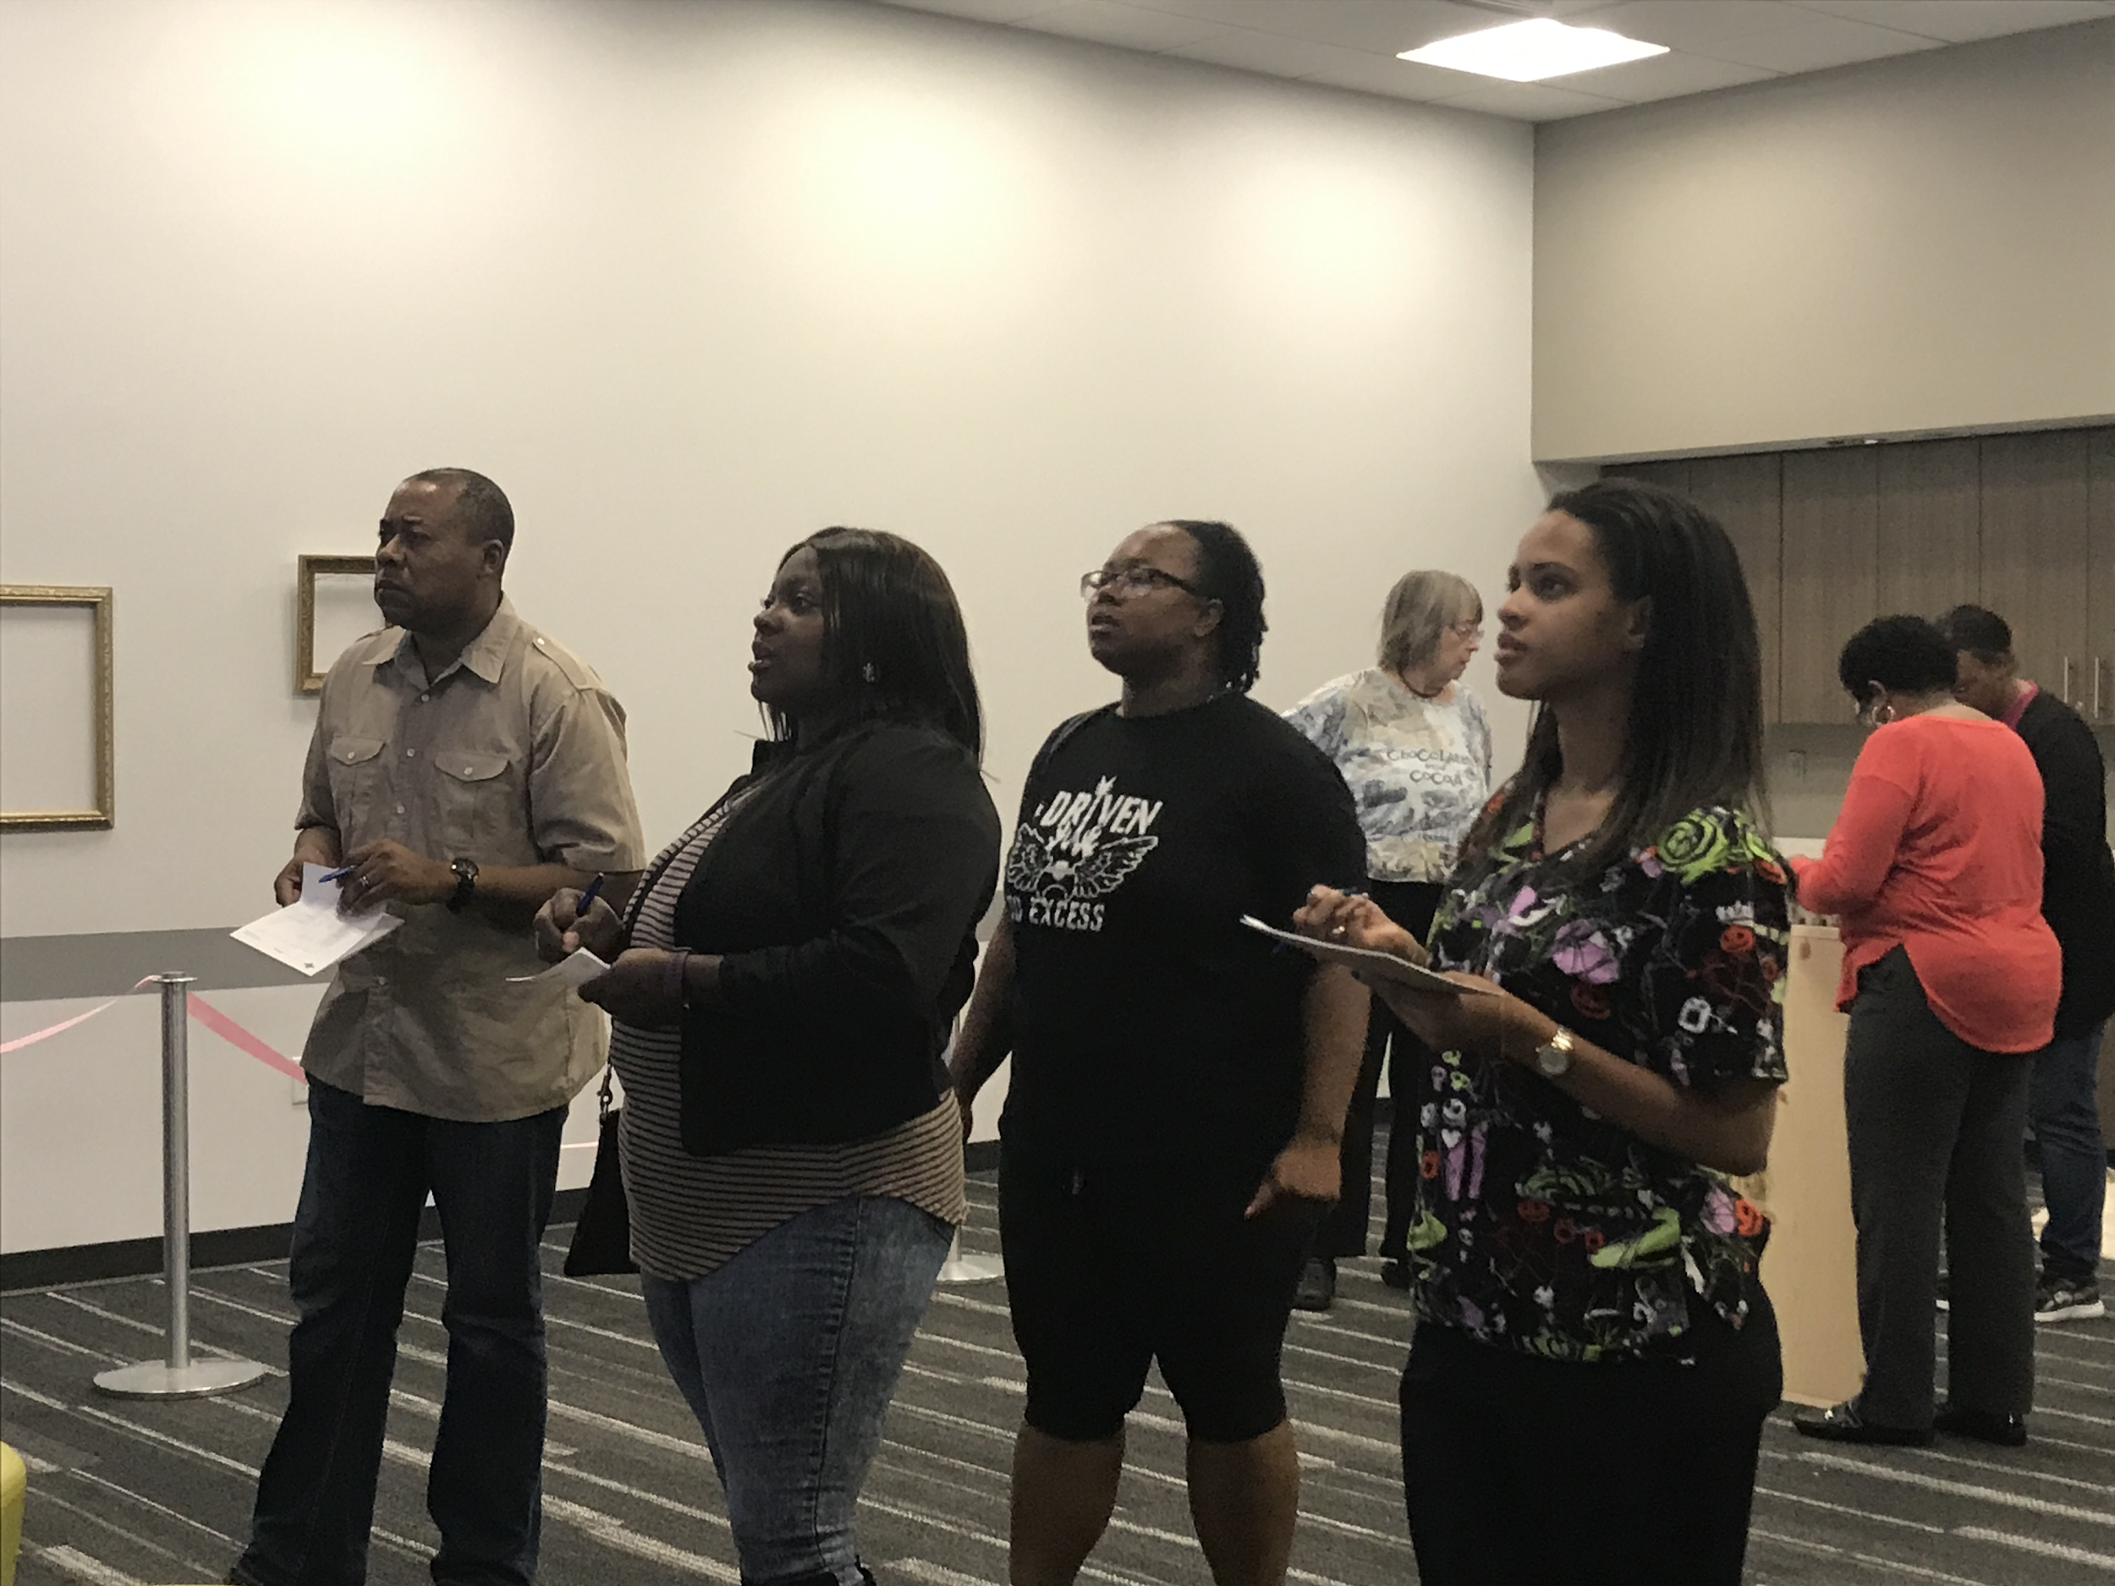
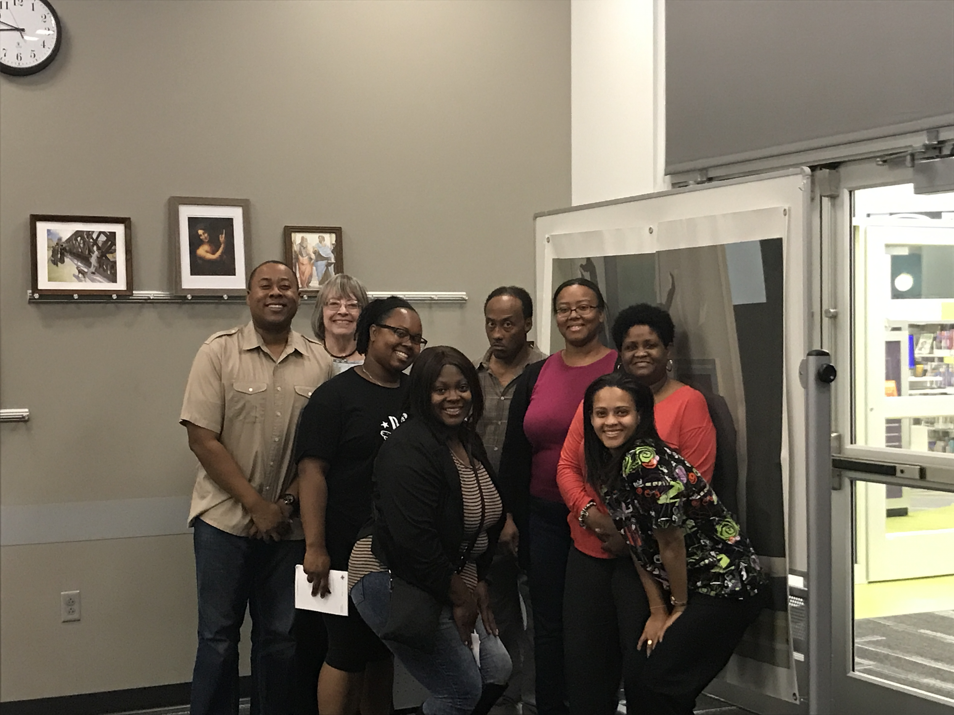
G
A
R
D
N
E
R
M
U
S
E
U
M
M
Y
S
T
E
R
Y
Problems:
We gave them hammers/mallets
Messy challenges
Puzzles didn’t make sense to players
Too few clues?

Slide 17
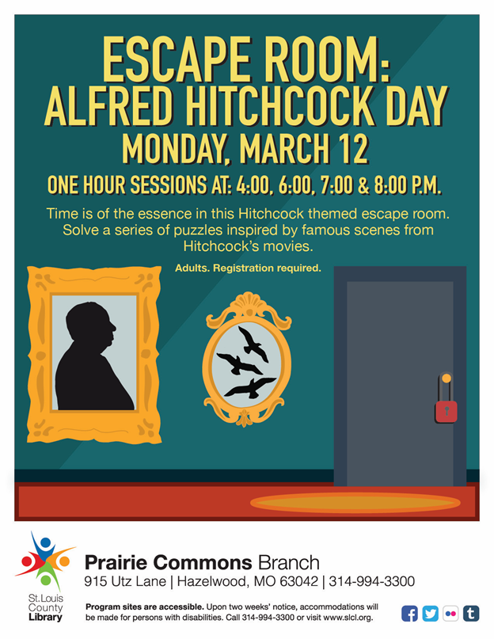
N
A
T
I
O
N
A
L
H
I
T
c
h
c
o
c
k
D
A
Y
Set-up & Premise:
National Alfred Hitchcock Day
Event theme guided puzzle concepts
Larger budget
Longer planning period
Raised number of spots per room

Slide 18
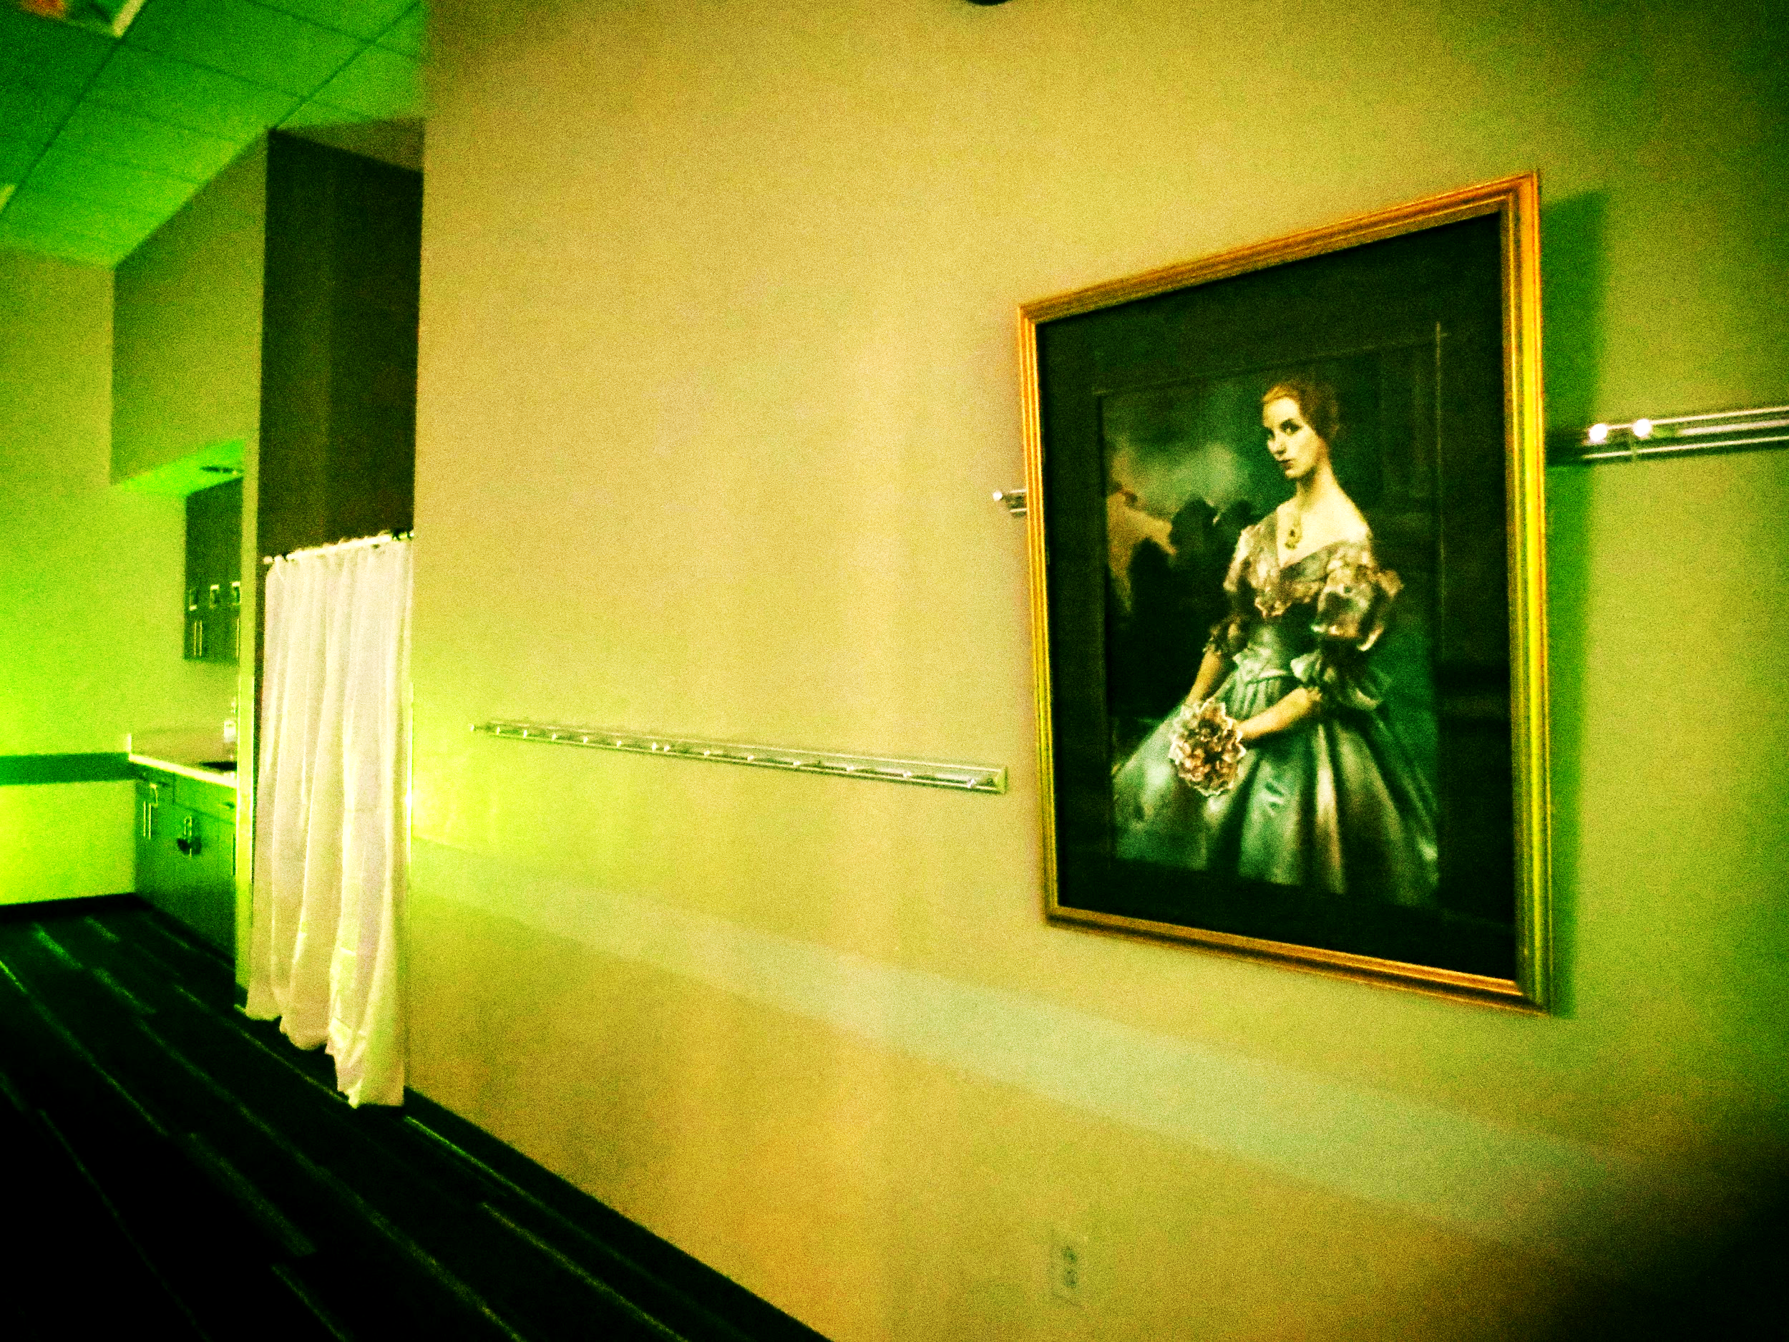
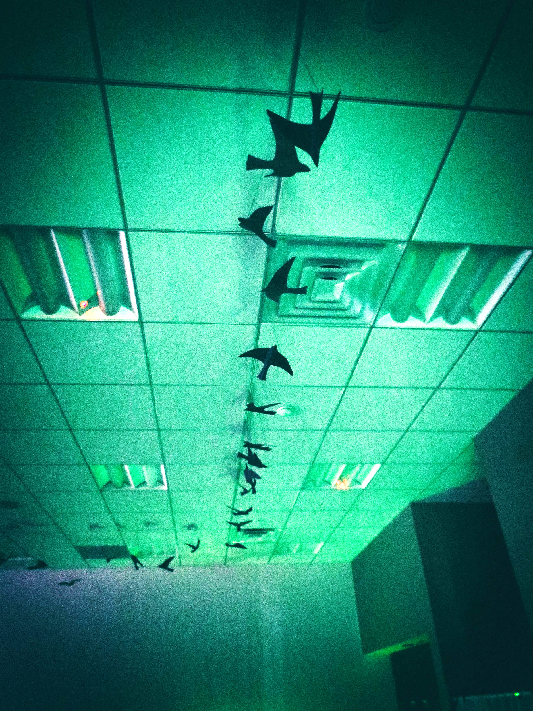
N
A
T
I
O
N
A
L
H
I
T
c
h
c
o
c
k
D
A
Y
Puzzles & Props
Puzzles inspired by films
Birds, shower curtain (of course)
Video: famous Hitchcock scenes reenacted
Water beads, wine bottles
Key puzzle maze

Slide 19
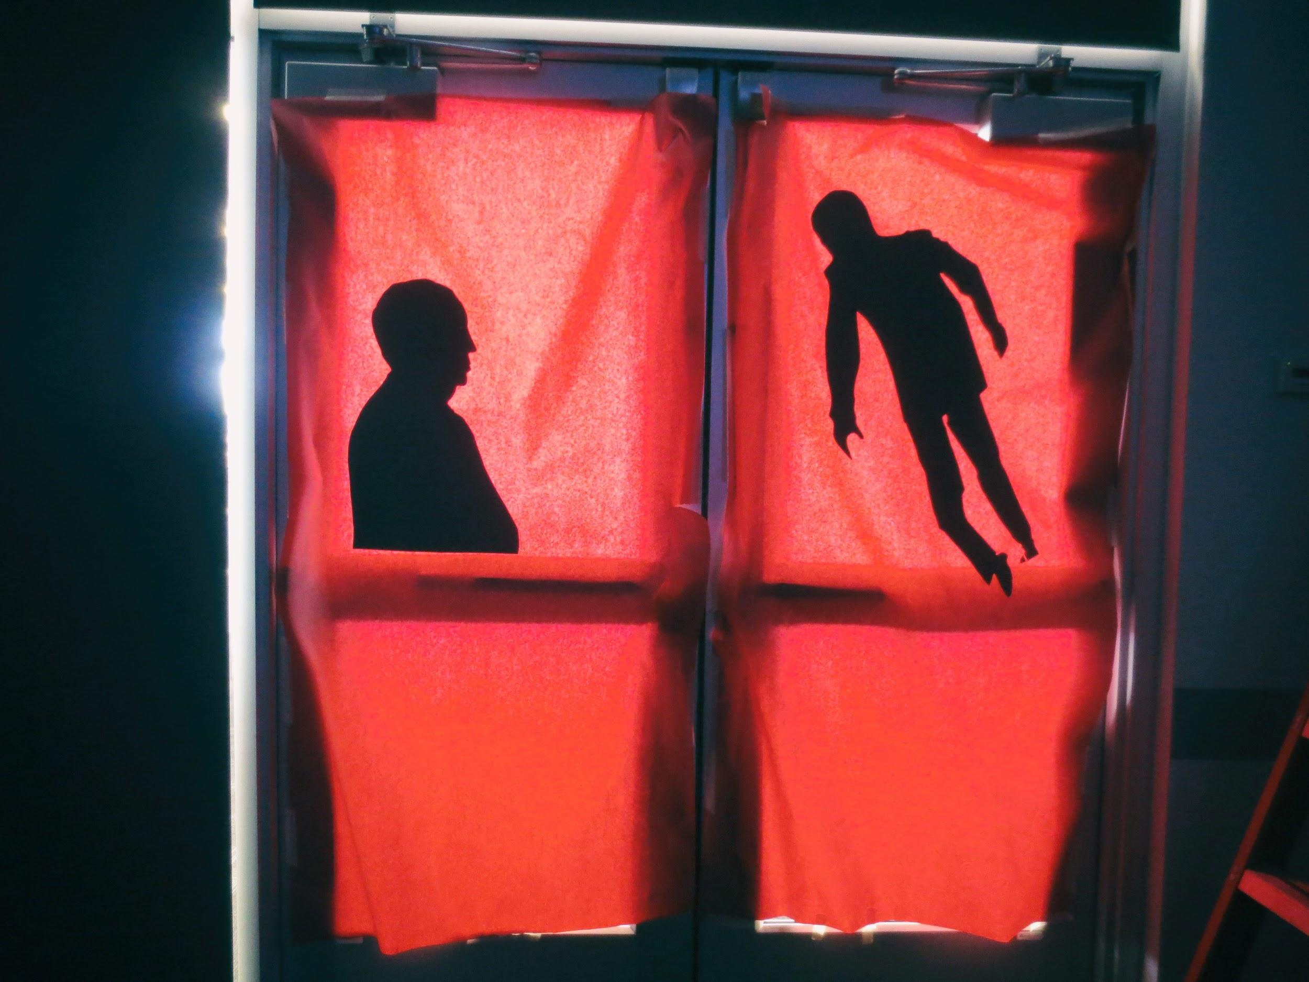
N
A
T
I
O
N
A
L
H
I
T
c
h
c
o
c
k
D
A
Y
Problems:
Binoculars didn’t work
Too much work!
Too many people (10 is perfect, 12 is ok, 15 is way too many)
A few players left the room early, quit out of frustration

Slide 20
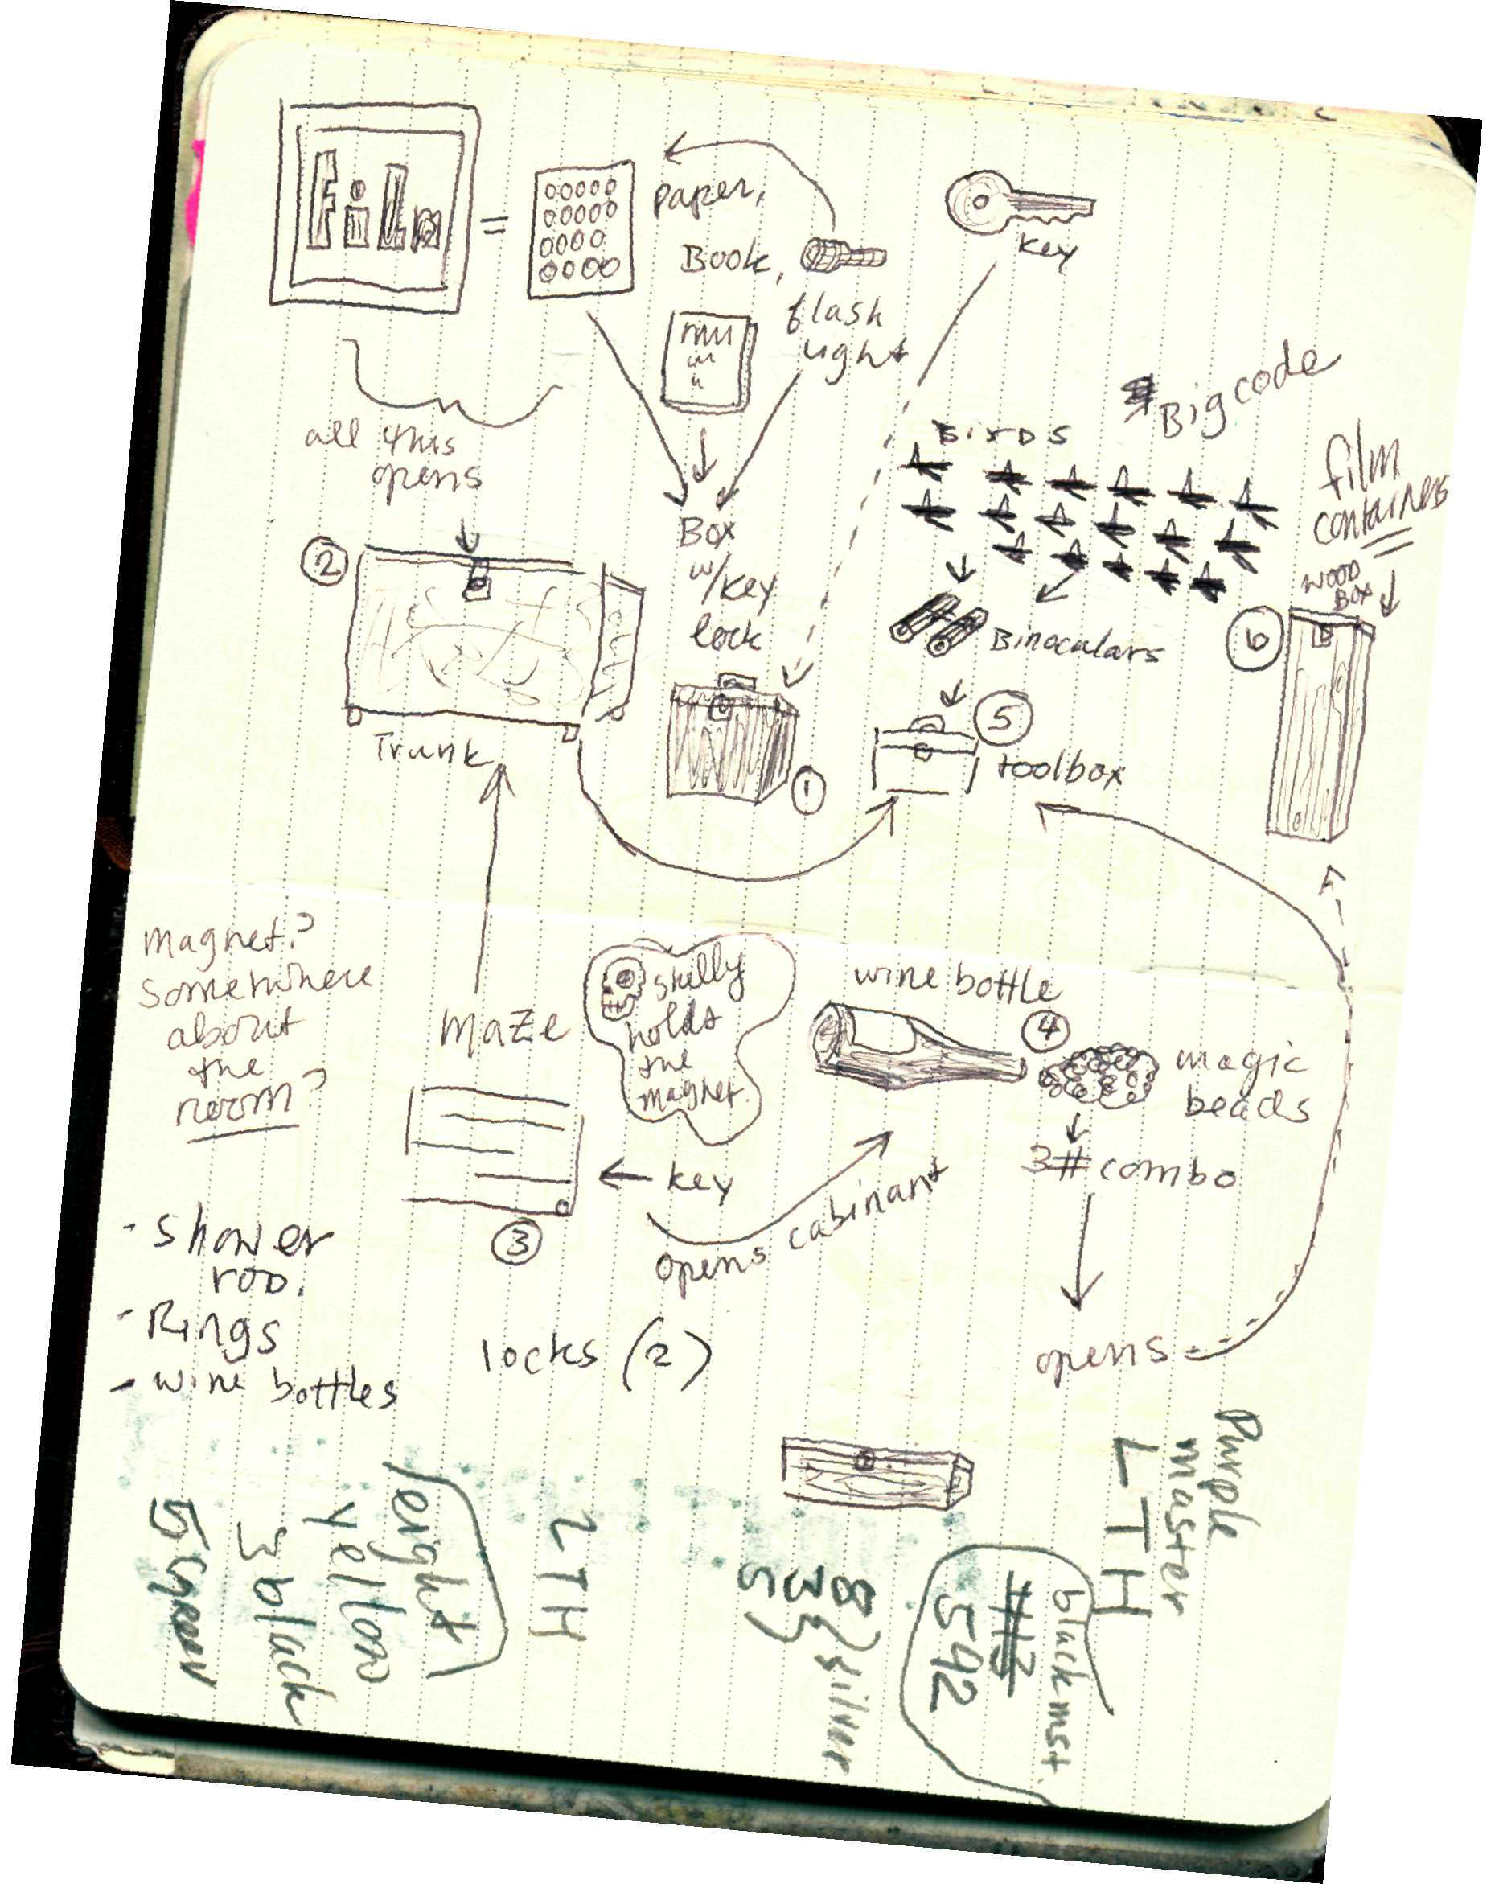
Things We Learned:
Plan in advance
Develop a fun and flexible theme
Include a wide variety of puzzle types so everyone can contribute
Evaluate
Try again!

Slide 21
Your Escape Room Ideas

Slide 22
Questions?
RESOURCES:
afreshwater@slcl.org
https://www.breakoutedu.com
https://www.pinterest.com/explore/room-escape-games/
http://blog.nowescape.com/101-best-puzzle-ideas-for-escape-rooms/
https://www.youtube.com/watch?v=F4wRZDbSfcQ
https://www.escapology.com

